Slide 1
CraCKING THE CODING INTERVIEW
A Brief Summary of Questions

Slide 2
Chapter1:
Arrays and Strings

Slide 3
Check Permutation: Are two Strings permutations of each otHer?

Slide 4
Clarifications
CHECK PERMUTATION
If the permutation is case sensitive.
White spaces should be considered.

Slide 5
Solution 1#: Sort the Strings and Compare
CHECK PERMUTATION

Slide 6
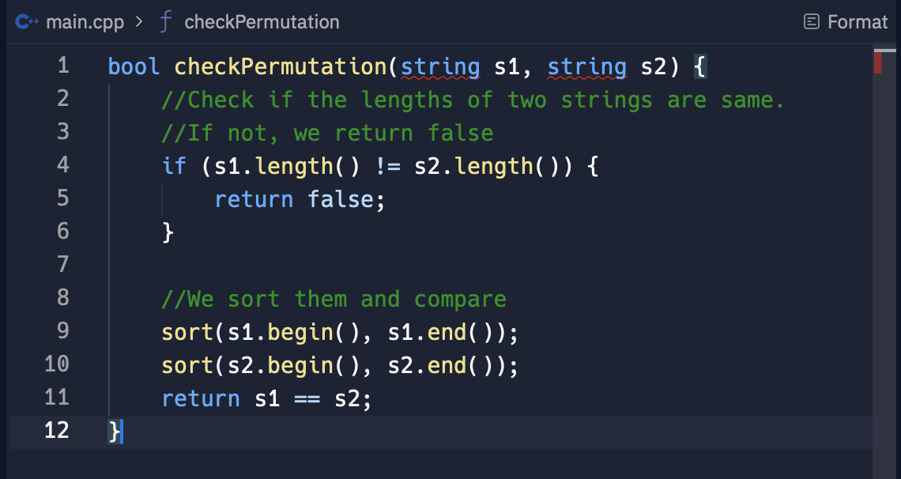
CHECK PERMUTATION
TC = O(n logn)
SC = O(1)

Slide 7
Solution 2#: CHECK CHARACTER COUNTS
CHECK PERMUTATION

Slide 8
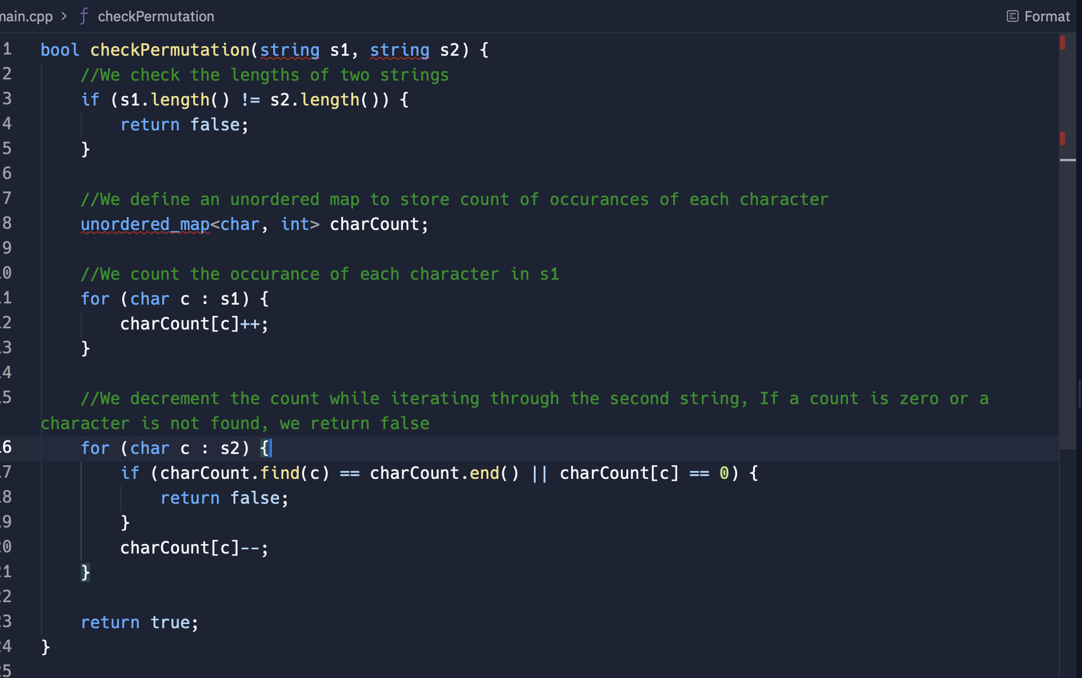
CHECK PERMUTATION
TC = O(n)
SC = O(n)

Slide 9
Which Solution is BETTER ?

Slide 11
Contiguous Sequence: Finding the Largest Sum in an Array

Slide 12
Clarifications
Whether the input array can include all negative numbers or zero.

Slide 13
Solution 1#: KADANES ALGORITHM
CONTIGUOUS SEQUENCE

Slide 14
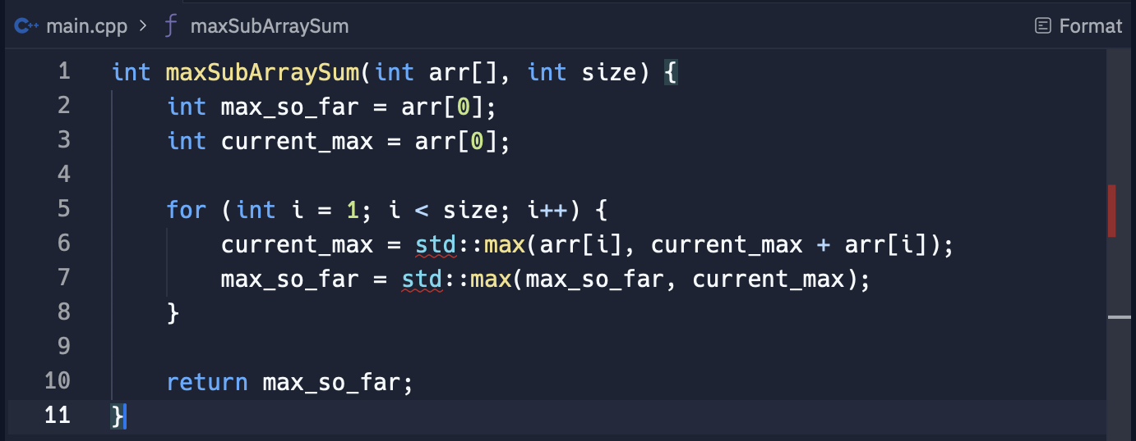
CONTIGUOUS SEQUENCE
Code
TC = O(n)
SC = O(1)

Slide 15
CONTIGUOUS SEQUENCE
Example Walkthrough
Consider the array: [−2, 1, −3, 4, −1, 2, 1, −5, 4]
Step-by-Step Execution:
Initialization:
current_max = -2 (First element)
max_so_far = -2 (Initial max)
Iterate Through the Array:
Index 1: Value = 1
current_max = max(1, -2 + 1) = max(1, -1) = 1
max_so_far = max(-2, 1) = 1
Index 2: Value = −3
current_max = max(−3, 1 + (−3)) = max(−3, −2) = −2
max_so_far remains 1
Index 3: Value = 4
current_max = max(4, −2 + 4) = max(4, 2) = 4
max_so_far = max(1, 4) = 4
Index 4: Value = −1
current_max = max(−1, 4 + (−1)) = max(−1, 3) = 3
max_so_far remains 4
Index 5: Value = 2
current_max = max(2, 3 + 2) = max(2, 5) = 5
max_so_far = max(4, 5) = 5
Index 6: Value = 1
current_max = max(1, 5 + 1) = max(1, 6) = 6
max_so_far = max(5, 6) = 6
Index 7: Value = −5
current_max = max(−5, 6 + (−5)) = max(−5, 1) = 1
max_so_far remains 6
Index 8: Value = 4
current_max = max(4, 1 + 4) = max(4, 5) = 5
max_so_far remains 6
Result:
The maximum sum of any contiguous subarray is 6.

Slide 17
IS UNIQUE: CHECKING FOR ALL UNIQUE CHARACTERS IN A STRING

Slide 18
Clarifications
Whether we are allowed to use additional data structures.

Slide 19
Solution 1#: USING BIT VECTOR OR ARRAY
IS UNIQUE

Slide 20
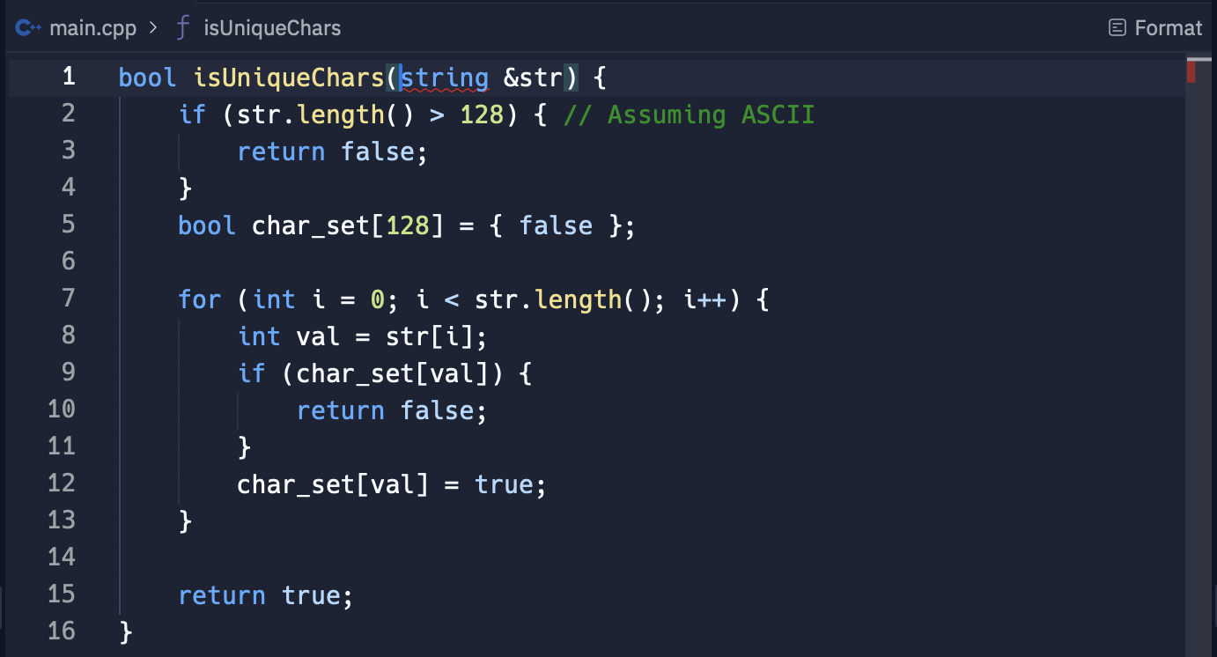
IS UNIQUE
Code
TC = O(n)
SC = O(1)

Slide 21
Solution 2#: WITHOUT USING ADDITIONAL DATA STRUCTURES
IS UNIQUE

Slide 22
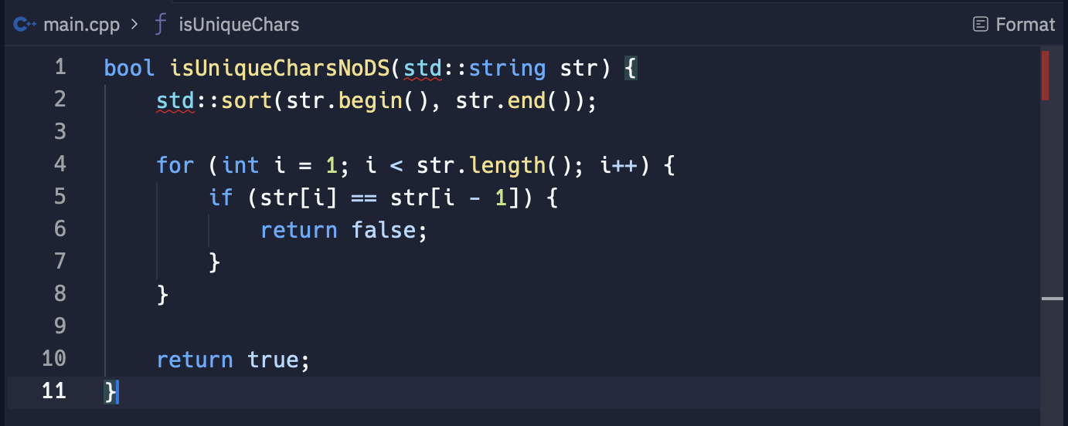
IS UNIQUE
TC = O(n logn)
SC = O(1)

Slide 23
PALINDROME PERMUTATION

Slide 24
Palindrome Permutation: Can a String be Rearranged into a Palindrome

Slide 25
Clarifications
PALINDROME PERMUTATION
Whether the input string includes spaces or punctuation as this can affect how we count character occurrences.

Slide 26
Solution 1#: Character Count occurrences
PALINDROME PERMUTATION

Slide 27
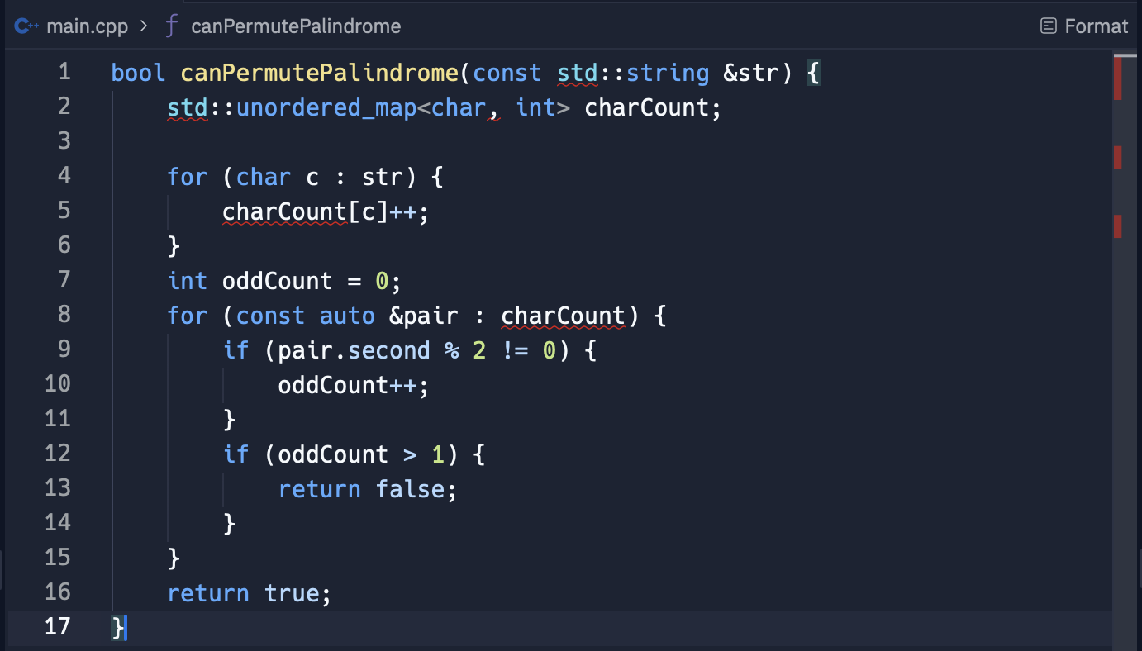
PALINDROME PERMUTATION
TC = O(n)
SC = O(n)

Slide 28
Solution 2#: USING a bit vector or array
PALINDROME PERMUTATION

Slide 29
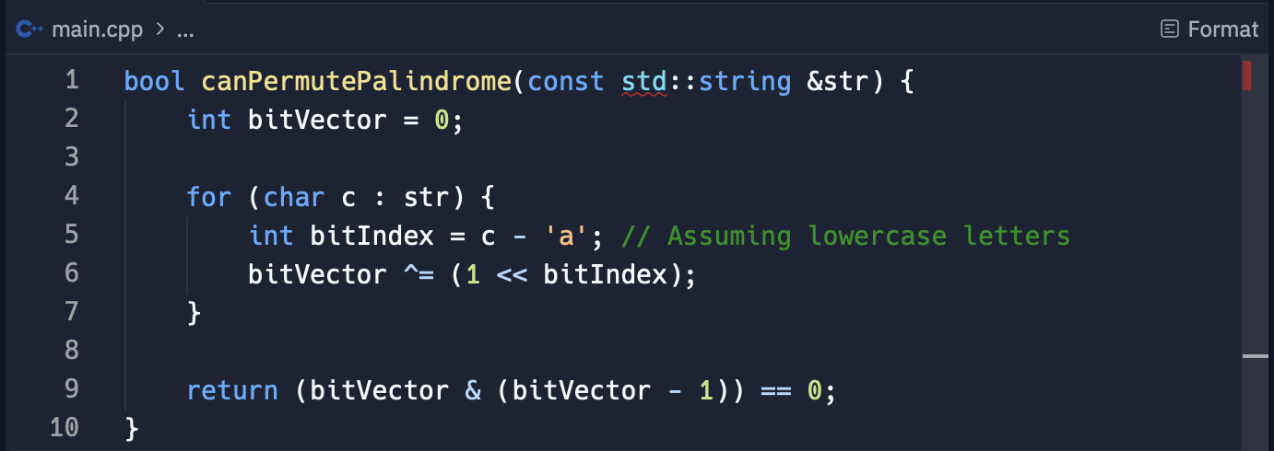
PALINDROME PERMUTATION
TC = O(n)
SC = O(1)

Slide 30
CHOOSING THE BEST SOLUTON
PALINDROME PERMUTATION

Slide 32
ONE AWAY: String Edit distaNce

Slide 33
Clarifications
ONE AWAY
Are there any constraints on types of edits allowed?
Should the function handle empty strings?
How should the function behave with strings that are already identical?

Slide 34
Solution Approach
ONE AWAY
Case1: Same length
Case 2: Length Difference of 1
Case 3: Length Difference More than 1

Slide 35
Solution: Checking one edit away
ONE AWAY

Slide 36
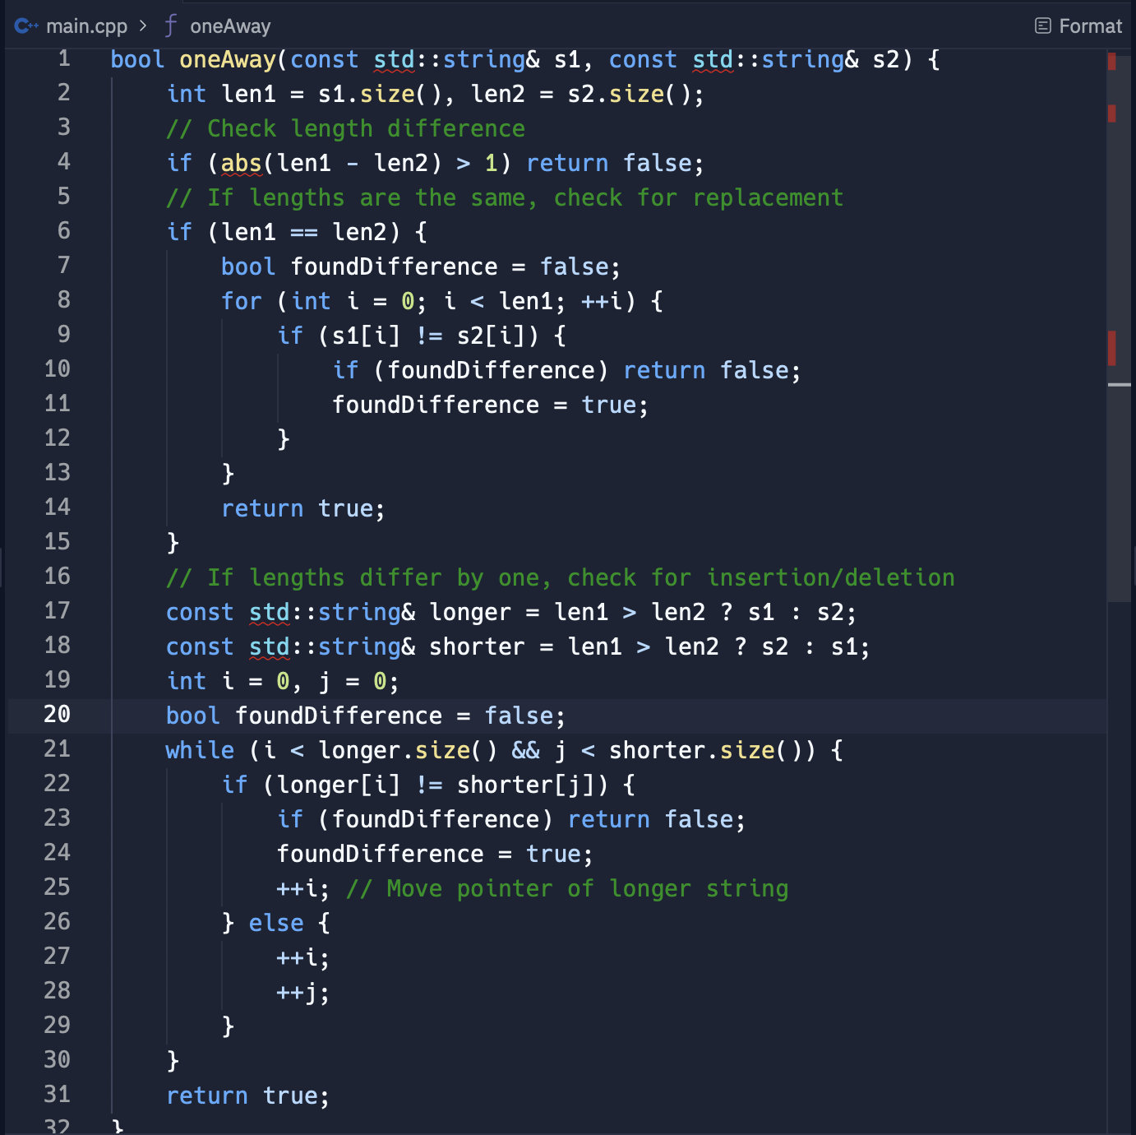
ONE AWAY
TC = O(n)
SC = O(1)

Slide 38
Rotate Matrix: Rotating an NxN Image by 90 Degrees

Slide 39
Clarifications
ROTATE MATRIX
Confirm if we are required to perform the rotation in place or if we can use additional space.
Also, clarify the matrix’s constraints such as its dimensions.

Slide 40
Solution 1#: Rotating in layers
ROTATE MATRIX

Slide 41
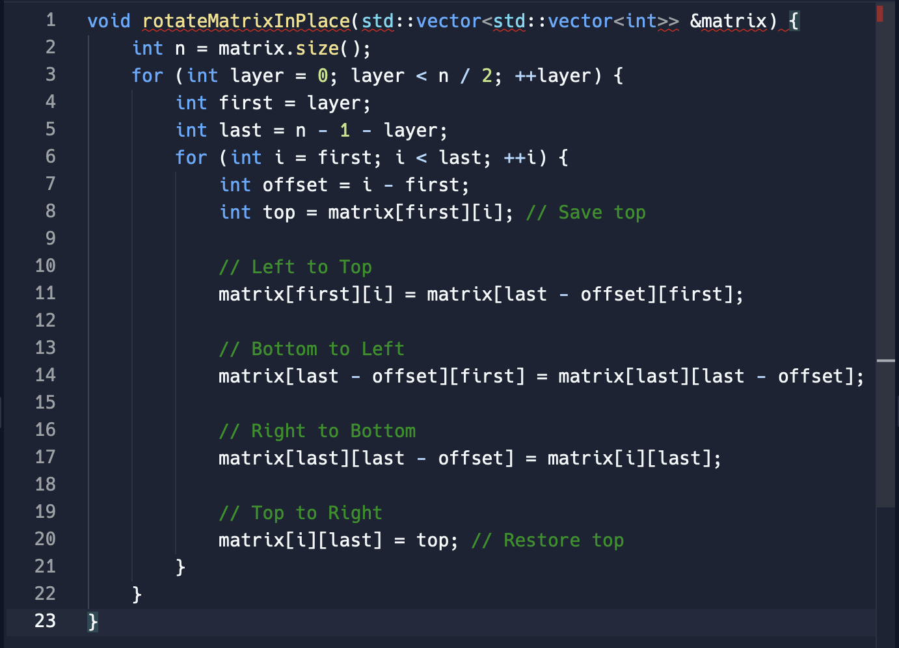
ROTATE MATRIX
TC = O(n^2)
SC = O(1)

Slide 42
Understanding the process
ROTATE MATRIX

Slide 44
STRing rotation: Checking if one string is rotation of another

Slide 45
Clarifications
STRING ROTATION
If there are special characters in string.

Slide 46
Solution 1#: CONCATENATE AND CHECK
STRING ROTATION

Slide 47
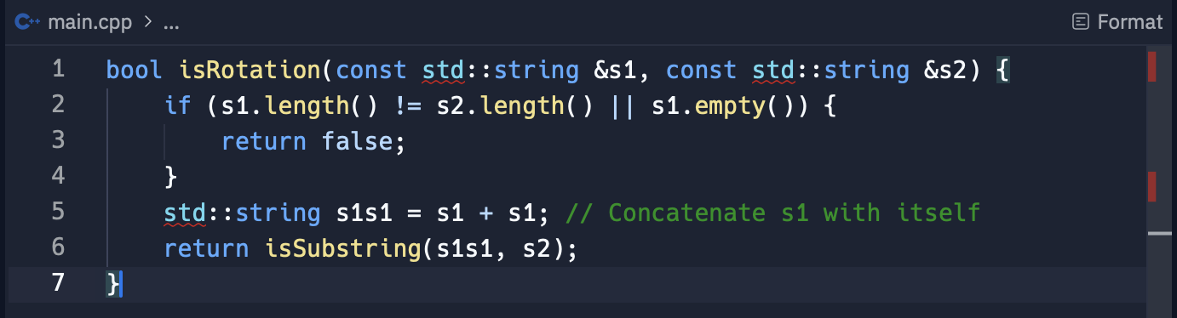
STRING ROTATION
TC = O(n)
SC = O(n)

Slide 48
Understanding the CONCATENATion approach
STRING ROTATION

Slide 50
STRING CONCATENATION: IMPLEMENTING basic COMPRESSION

Slide 51
Clarifications
STRING COMPRESSION
Are there any contraints on the maximum length of the input string?
Should the compression handle edge cases, such as empty string or single-character strings?
How the functions behave with the strings that are already compressed or have no repeating character?

Slide 52
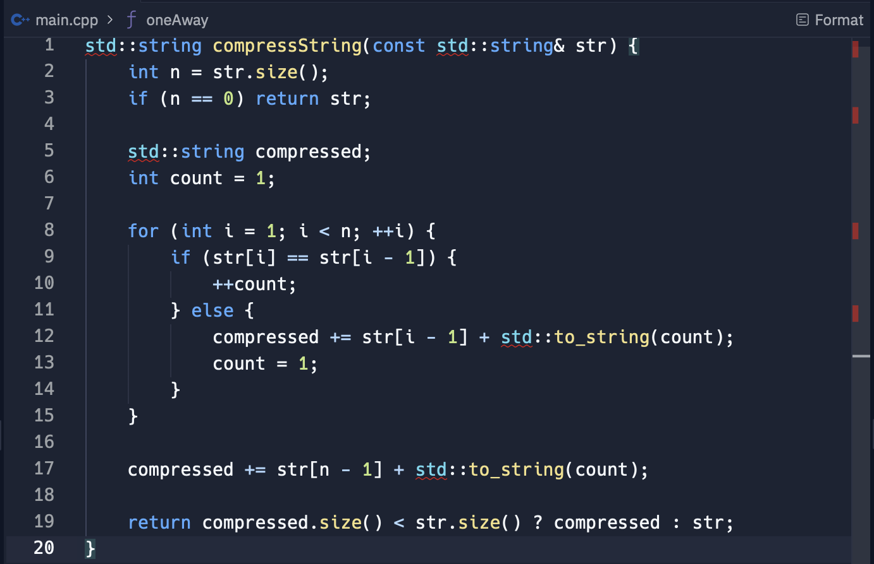
STRING COMPRESSION
TC = O(n)
SC = O(n)

Slide 54
URLify: Replacing Spaces with '%20' in a String
URLIFY

Slide 55
Clarifications
URLIFY
Clarify if the string has sufficient space allocated for replacements.

Slide 56
Solution 1#: in place replacement
URLIFY

Slide 57
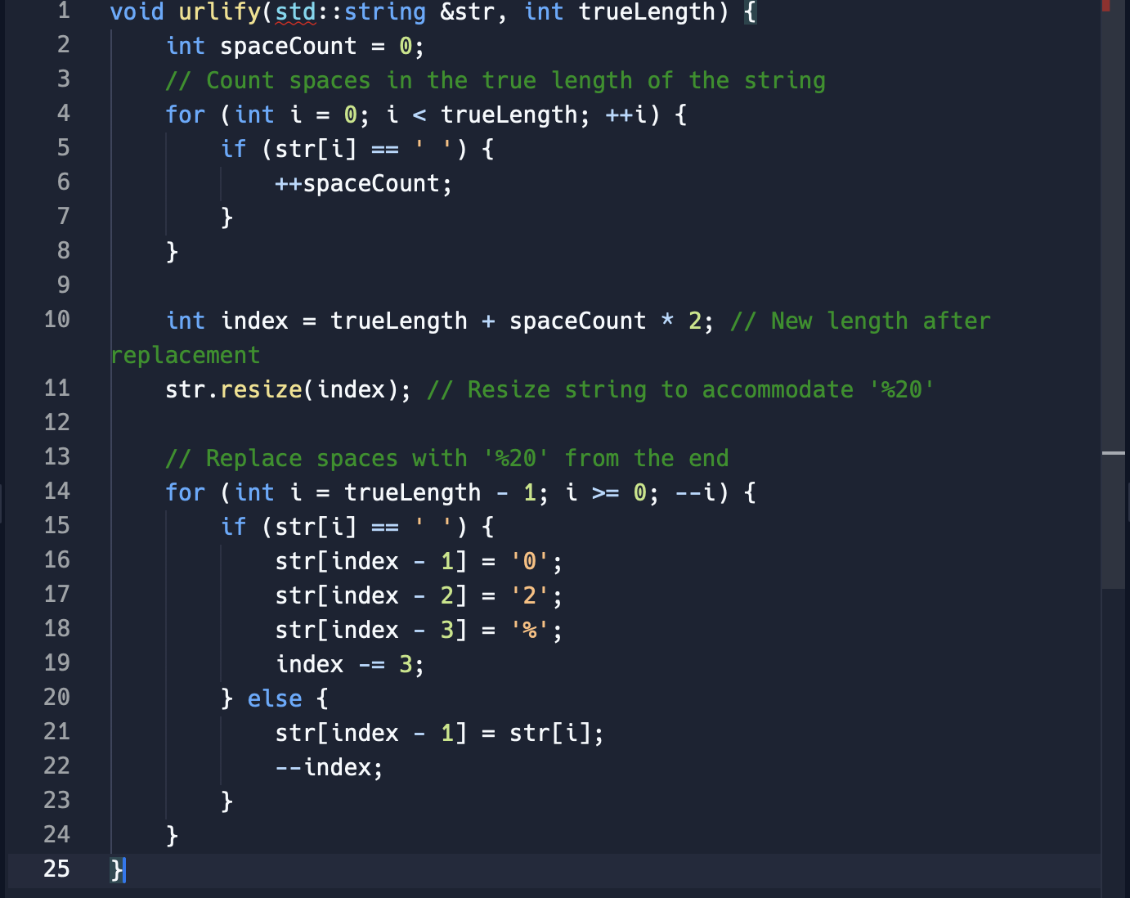
URLIFY
TC = O(n)
SC = O(n)

Slide 59
Zero Matrix: Setting Rows and Columns to Zero

Slide 60
Clarifications
ZERO MATRIX
If we need to handle the matrices with one row or one column separately.

Slide 61
Solution 1#: USING EXTRA SPACE
ZERO MATRIX

Slide 62
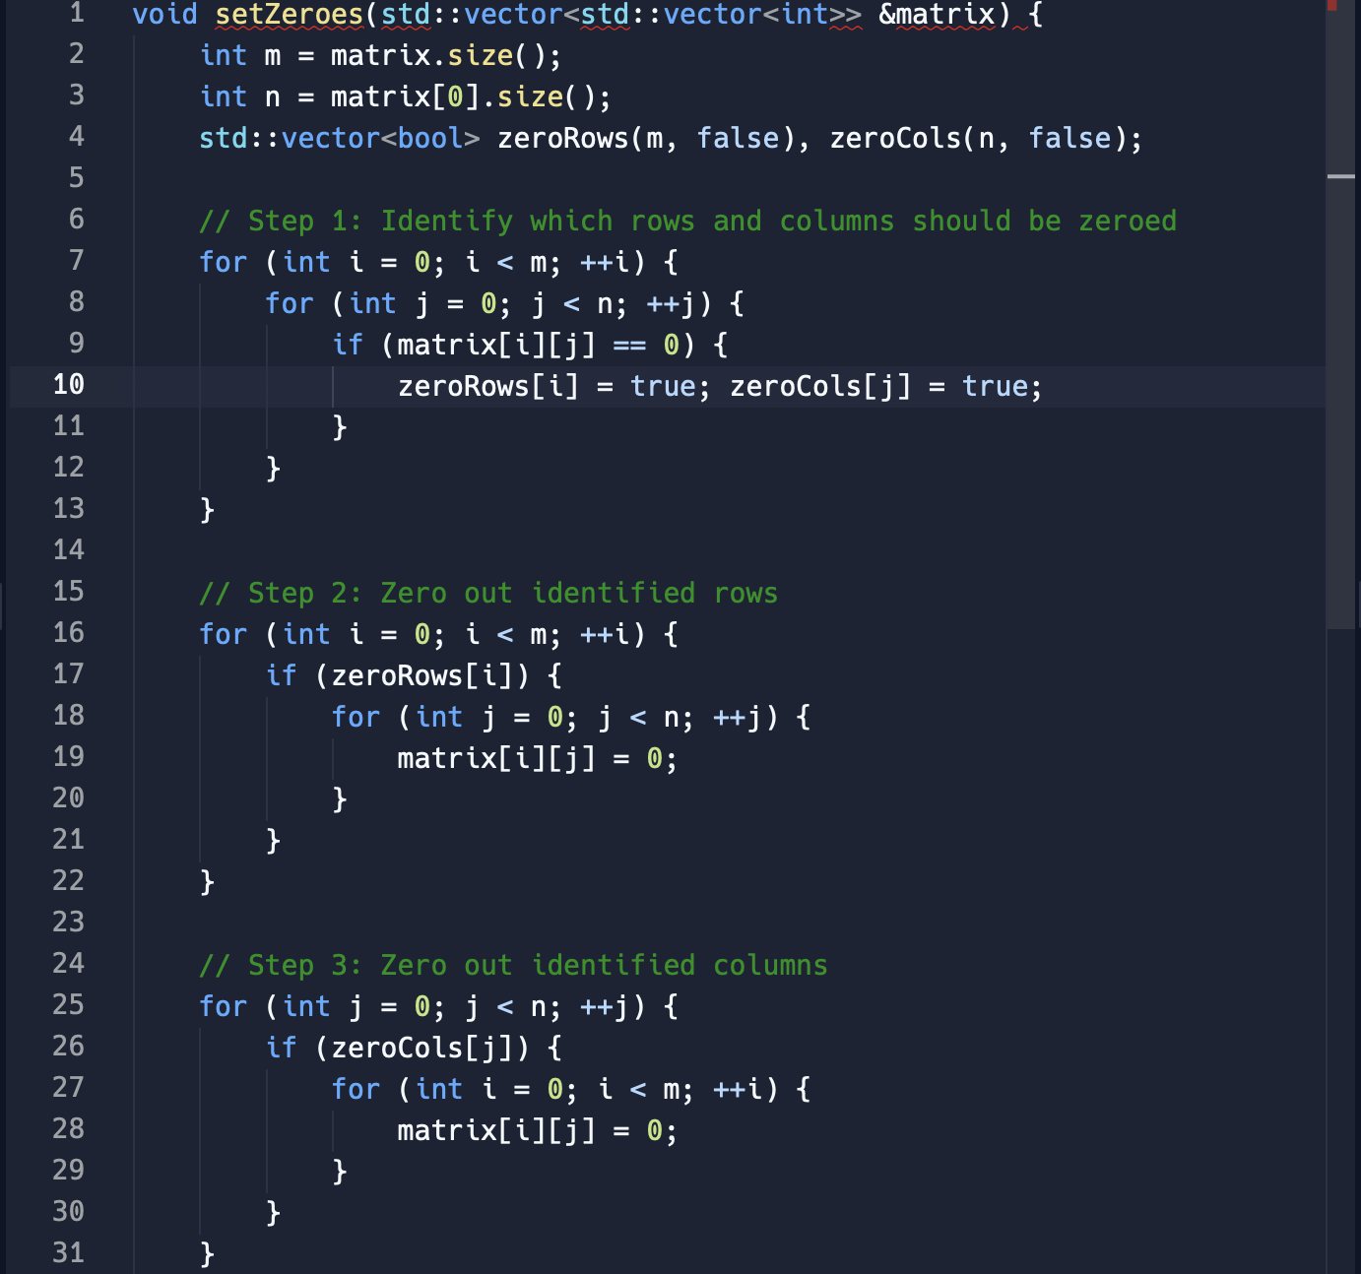
ZERO MATRIX
TC = O(m * n)
SC = O(m + n)

Slide 63
Solution 2#: In place using first row and column
ZERO MATRIX

Slide 64
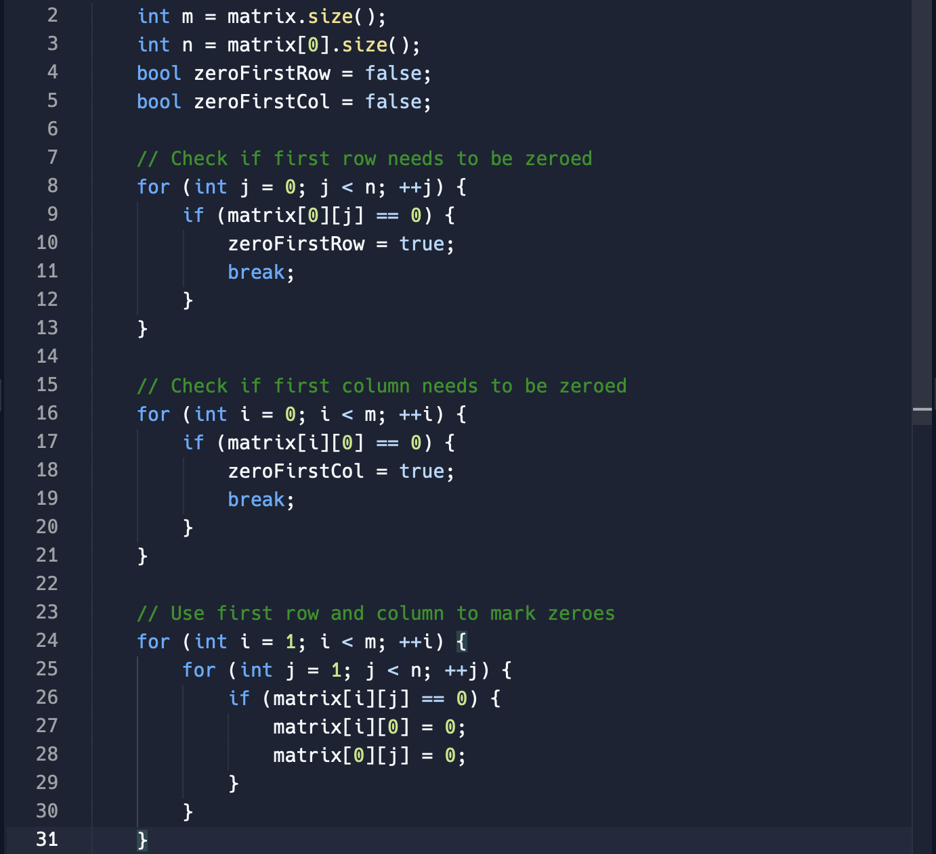
ZERO MATRIX
TC = O(m * n)
SC = O(1)

Slide 65
Conclusion and tips

Slide 66
Remember to always ask clarifying questions before starting your solution.
Always think from a simple solution then build up from it.
Practise and revise as often as possible.

Slide 67
Thank you for watching!

